Slide 1
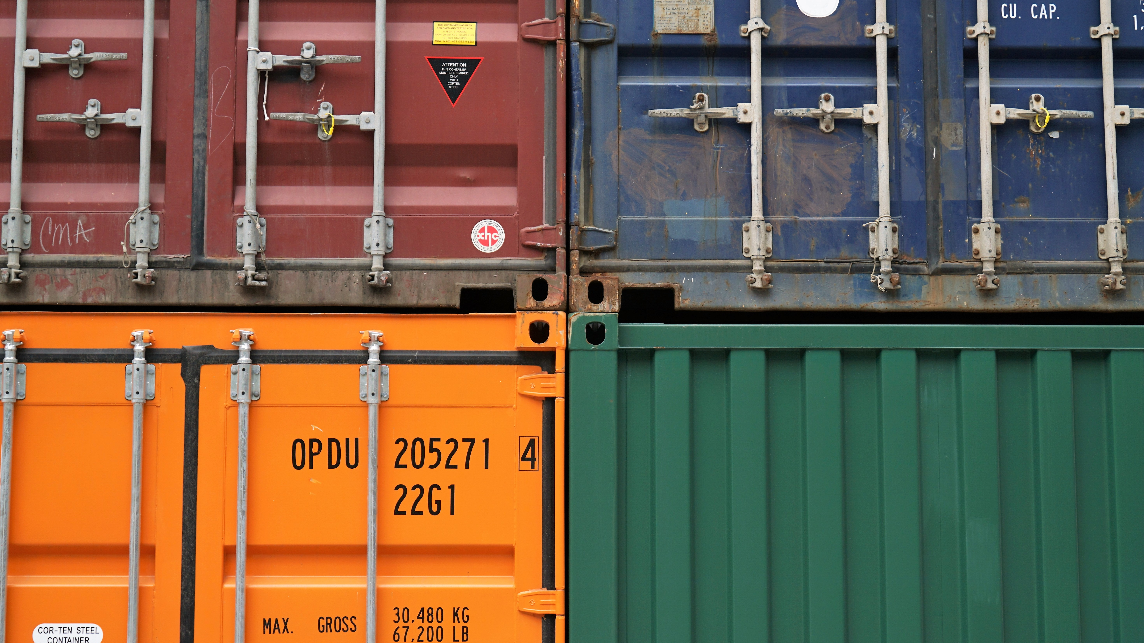


What If? Evaluating decarbonization strategies for maritime cargo flows in Liverpool City Region
Patrick Ballantyne, Alex Singleton

Slide 2







Today’s Talk
Context
Why?
Data
Likely destination estimation
Likely route prediction
Discussion: next steps

Slide 3
Context

Slide 4
Context
[2022] LCR CA secured the Liverpool City Region Sustainable Transport Settlement (CRSTS 1):
Evidence-led transport development pipeline to support transition to net zero and generate positive outcomes for people in LCR.
Total awarded was £710m, to cover 2022-2027.
E.g., James St Station, Baltic Triangle (£156m)

Slide 5
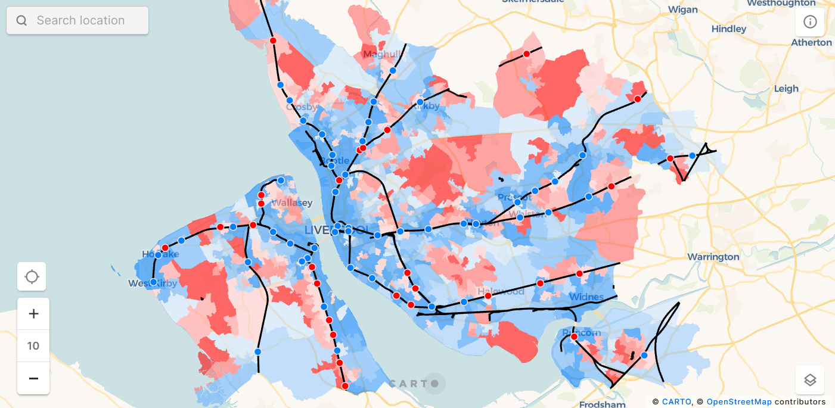
Context
[2022] LCR CA secured the Liverpool City Region Sustainable Transport Settlement (CRSTS 1):
Evidence-led transport development pipeline to support transition to net zero and generate positive outcomes for people in LCR.
Total awarded was £710m, to cover 2022-2027.
E.g., James St Station, Baltic Triangle (£156m)
[2023] CRSTS 2:
Bidding for similar amount, to cover 2027+
Less concerned with schemes, more about problems and specific interventions to address these.
Place-based approach: mapping and scoring areas based on priorities

Slide 6
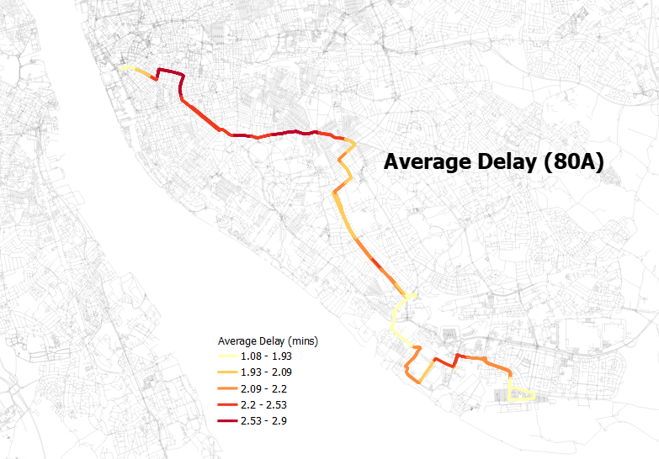
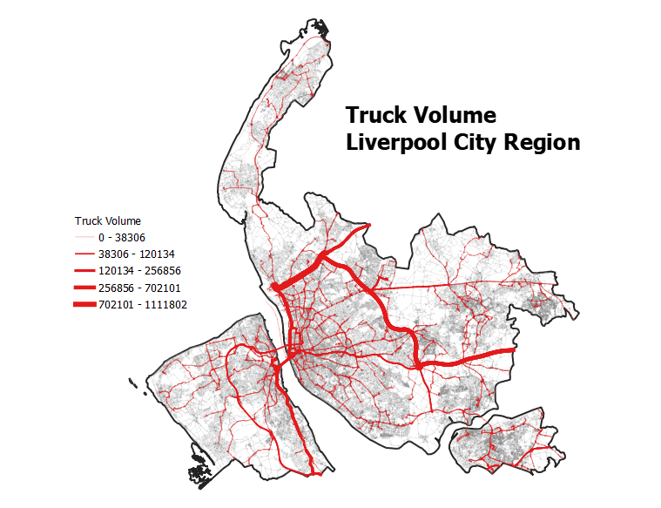
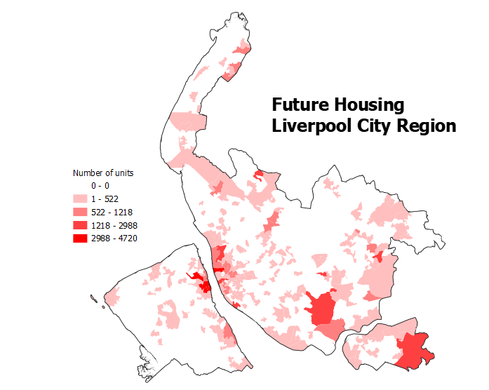
Context
[2022] LCR CA secured the Liverpool City Region Sustainable Transport Settlement (CRSTS 1):
Evidence-led transport development pipeline to support transition to net zero and generate positive outcomes for people in LCR.
Total awarded was £710m, to cover 2022-2027.
E.g., James St Station, Baltic Triangle (£156m)
[2023] CRSTS 2:
Bidding for similar amount, to cover 2027+
Less concerned with schemes, more about problems and specific interventions to address these.
Place-based approach: mapping and scoring areas based on priorities
Other outcomes:
LOTS of data, impact and papers (I hope)…

Slide 7
What If? Evaluating decarbonization strategies for maritime cargo flows in Liverpool City Region
Patrick Ballantyne, Alex Singleton

Slide 8
Why?

Slide 9
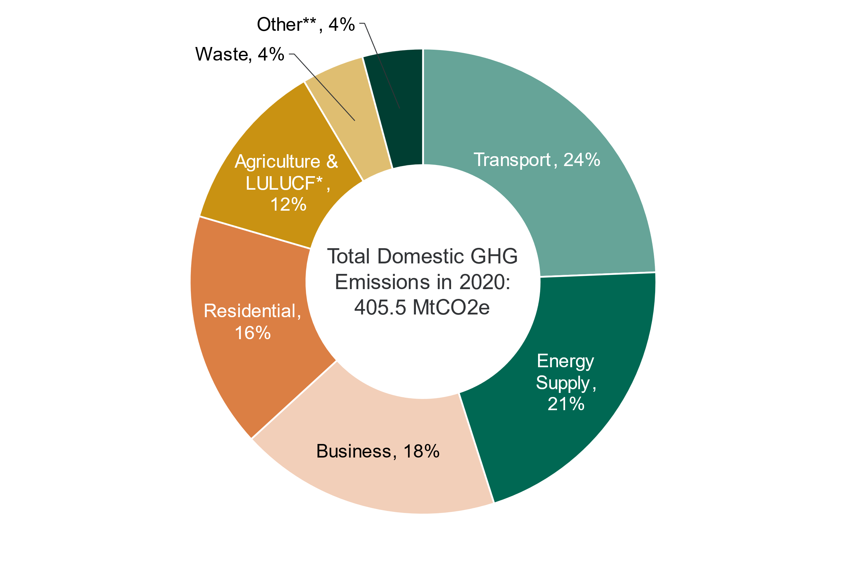
Why?
Transport is the largest emitting sector of GHGs in the UK: 24% of GHG emissions come from the sector

Slide 10
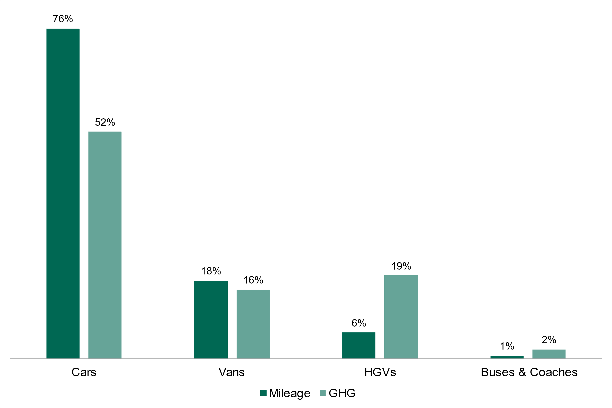
Why?
Transport is the largest emitting sector of GHGs in the UK: 24% of GHG emissions come from the sector
Whilst HGVs make up a smaller share of total miles nationally, the emissions they generate are disproportionately greater*
*HGVs are less fuel efficient than private cars, and travel longer distances with greater loads

Slide 11

Why?
Transport is the largest emitting sector of GHGs in the UK: 24% of GHG emissions come from the sector
Whilst HGVs make up a smaller share of total miles nationally, the emissions they generate are disproportionately greater*
Lots of evidence linking these emissions to negative impacts for public and environmental health†
*HGVs are less fuel efficient than private cars, and travel longer distances with greater loads
† Teixeira et al., 2021; Tang et al., 2020; Mak and Ng, 2021.

Slide 12
Why?
Transport is the largest emitting sector of GHGs in the UK: 24% of GHG emissions come from the sector
Whilst HGVs make up a smaller share of total miles nationally, the emissions they generate are disproportionately greater*
Lots of evidence linking these emissions to negative impacts for public and environmental health†
HGV routes (and emissions) are spatial and could result in social and spatial inequalities
*HGVs are less fuel efficient than private cars, and travel longer distances with greater loads
† Teixeira et al., 2021; Tang et al., 2020; Mak and Ng, 2021.

Slide 13
Data

Slide 14
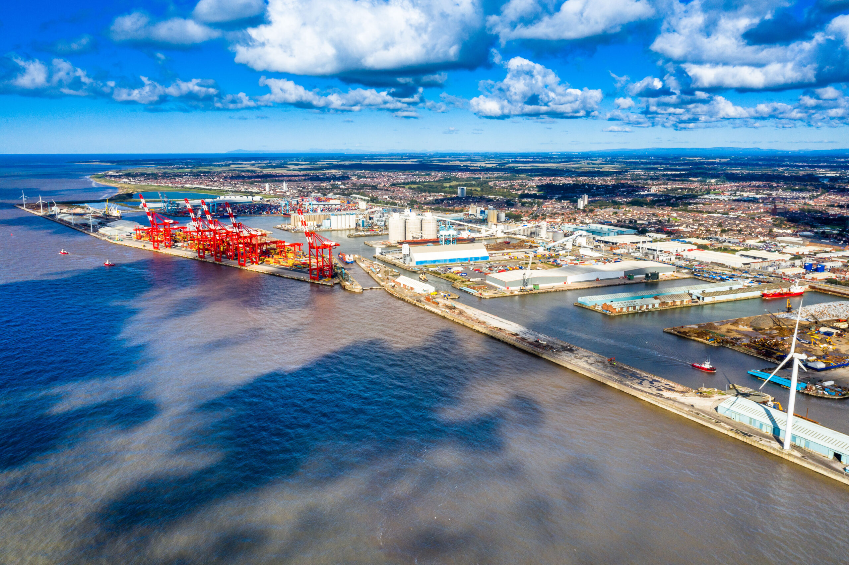
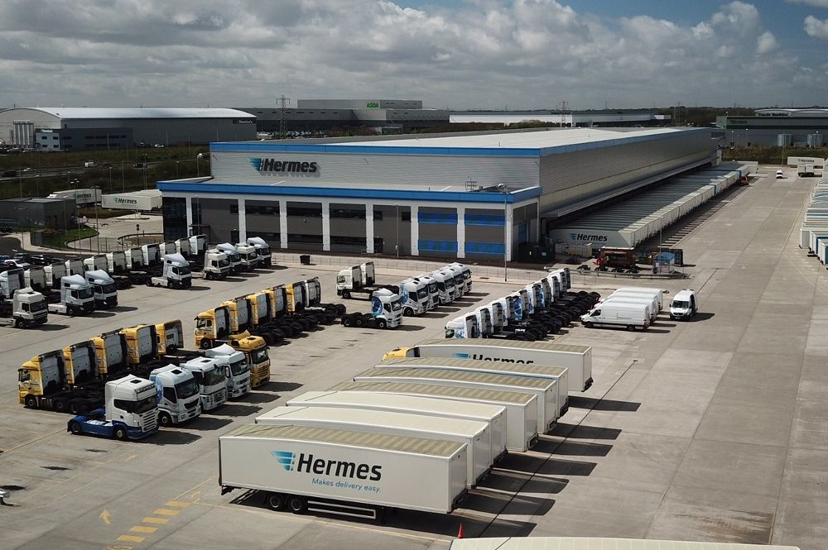
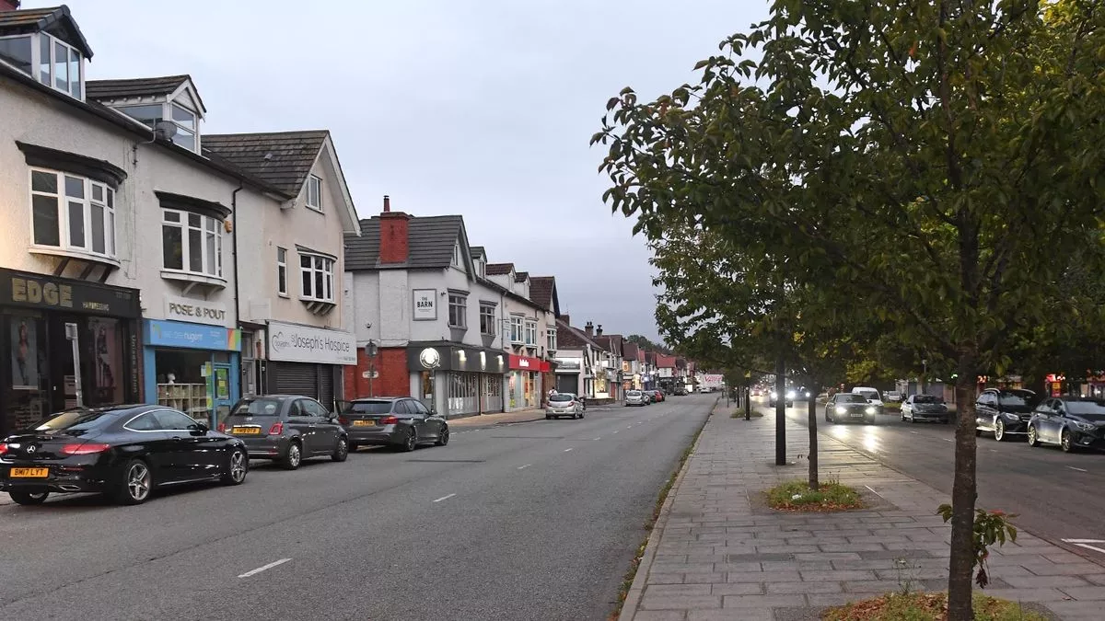
Data
OD Data for Freight at Port of Liverpool (and Birkenhead):
Provided by MDS Transmodal, via LCR CA.
Destinations are GBFM Zones*
Truck volumes along OD pairs
Temporal scale: ‘1 year’
*Great Britain Freight Model (GBFM), https://www.gov.uk/government/publications/great-britain-freight-model-version-5-2022-updates.

Slide 15
Data
OD Data for Freight at Port of Liverpool (and Birkenhead):
Provided by MDS Transmodal, via LCR CA.
Destinations are GBFM Zones*
Truck volumes along OD pairs
Temporal scale: ‘1 year’
GBFM Zone | D-Latitude | D-Longitude | ImportExport | SeaMode | Port | O-Latitude | O-Longitude | TotalUnits
1 | 53.6235 | -2.2042 | Imp | Unaccompanied Trailer | Liverpool | 53.4067 | -2.9945 | 12.803
1 | 53.6235 | -2.2042 | Imp | Shipborne port-to-port trailer | Liverpool | 53.4067 | -2.9945 | 1.367
1 | 53.6235 | -2.2042 | Exp | Accompanied HGV | Liverpool | 53.4067 | -2.9945 | 0.282
1 | 53.6235 | -2.2042 | Exp | Unaccompanied Trailer | Liverpool | 53.4067 | -2.9945 | 0.776
1 | 53.6235 | -2.2042 | Exp | Shipborne port-to-port trailer | Liverpool | 53.4067 | -2.9945 | 0.077
1 | 53.6235 | -2.2042 | Imp | Accompanied HGV | Liverpool | 53.4067 | -2.9945 | 4.713
2 | 53.6109 | -2.1967 | Imp | Unaccompanied Trailer | Liverpool | 53.4067 | -2.9945 | 3.671
2 | 53.6109 | -2.1967 | Imp | Shipborne port-to-port trailer | Liverpool | 53.4067 | -2.9945 | 0.383
2 | 53.6109 | -2.1967 | Exp | Accompanied HGV | Liverpool | 53.4067 | -2.9945 | 0.566
2 | 53.6109 | -2.1967 | Exp | Unaccompanied Trailer | Liverpool | 53.4067 | -2.9945 | 1.562
2 | 53.6109 | -2.1967 | Exp | Shipborne port-to-port trailer | Liverpool | 53.4067 | -2.9945 | 0.155
2 | 53.6109 | -2.1967 | Imp | Accompanied HGV | Liverpool | 53.4067 | -2.9945 | 1.346
*Great Britain Freight Model (GBFM), https://www.gov.uk/government/publications/great-britain-freight-model-version-5-2022-updates.

Slide 16
Likely destination estimation

Slide 17


Likely destination estimation
GBFM Zones, i.e., destinations
Lots of problems

Slide 18
Likely destination estimation
GBFM Zones, i.e., destinations
Lots of problems
Accurate destinations?
Centroid reconfiguration

Slide 19
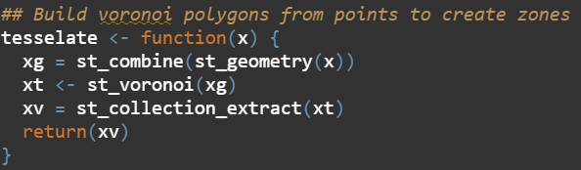
Likely destination estimation
Voronoi tessellation:

Slide 20
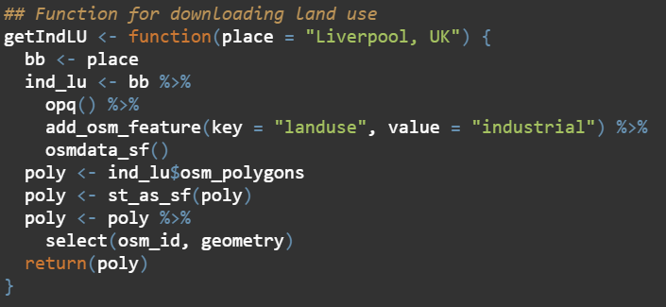
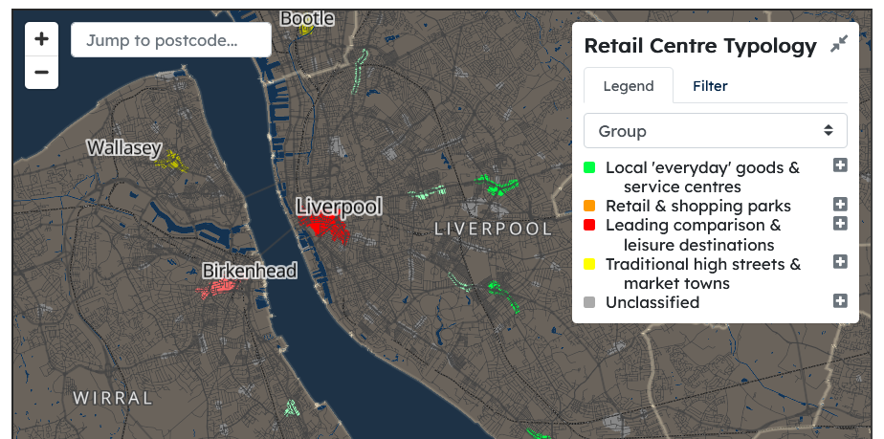

Likely destination estimation
Industrial land-uses:
Retail centres:

Slide 21
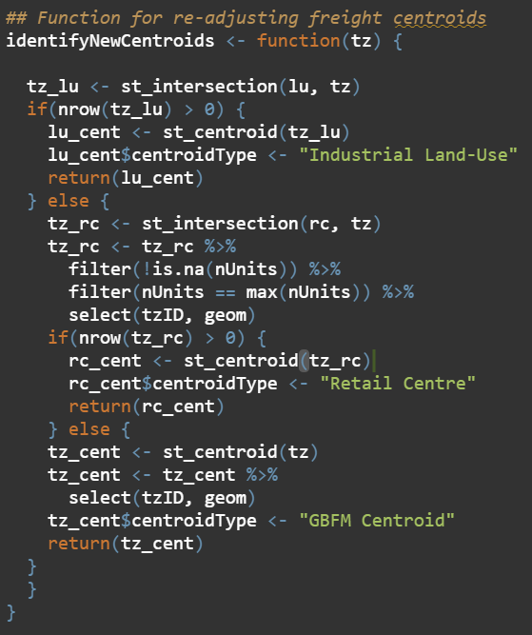
Likely destination estimation
A decision tree (sort of):

Slide 22
Likely destination estimation

Slide 23
Likely route estimation

Slide 24
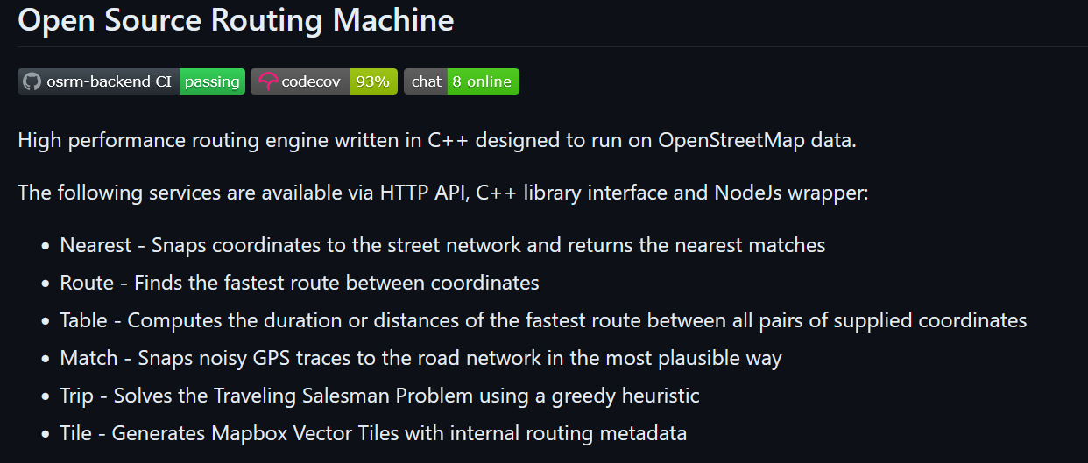
Likely route estimation
Notes:
Open Source Routing Machine; set up with a road network for trucks specifically (i.e., rules, tunnels), osrmR package
Give it the OD pairs, creates most likely routes between pairs, linestring bundles
Stplanr takes the linestrings, combines into segments applying function of total trucks per route.

Slide 25

Likely route estimation
Notes:
Open Source Routing Machine; set up with a road network for trucks specifically (i.e., rules, tunnels), osrmR package
Give it the OD pairs, creates most likely routes between pairs, linestring bundles
Stplanr takes the linestrings, combines into segments applying function of total trucks per route.

Slide 26
Likely route estimation
Thicker lines = More trucks

Slide 27
Likely route estimation
Thicker lines = More emissions

Slide 28
Discussion: next steps

Slide 29
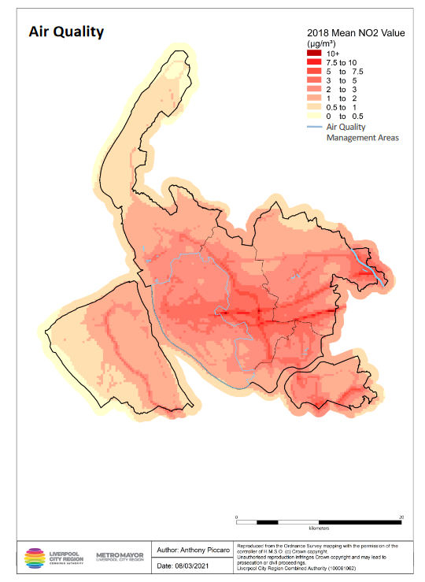
Discussion: next steps
Quantifying GHG emissions and exposure from HGVs in LCR CA

Slide 30
Discussion: next steps
Quantifying GHG emissions and exposure from HGVs in LCR CA
Understanding the socio-economic characteristics of population exposure

Slide 31
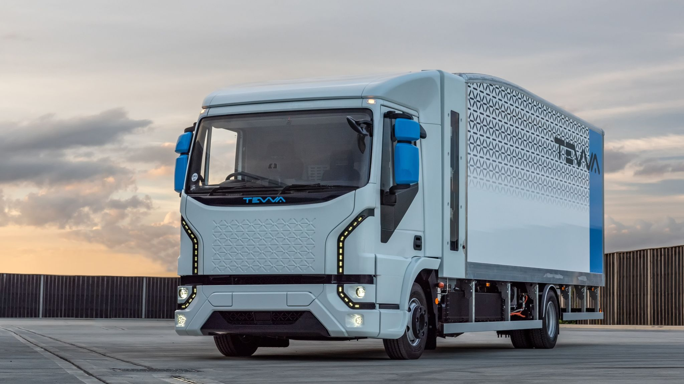
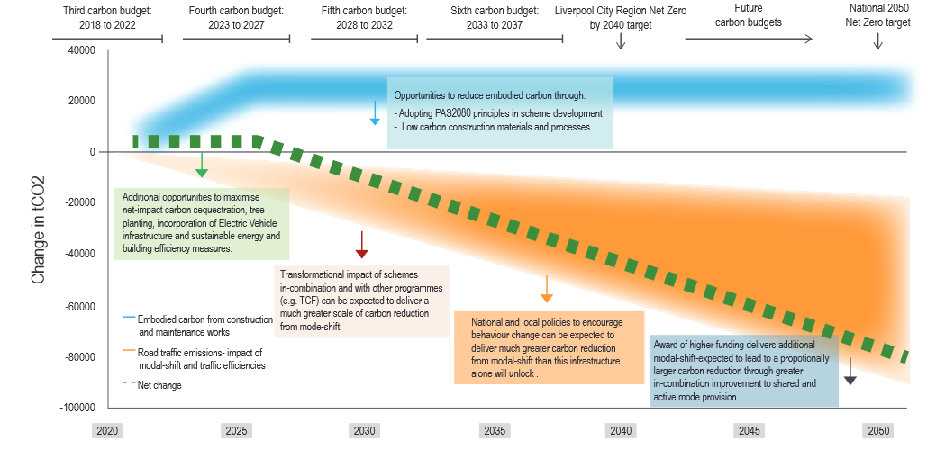
Discussion: next steps
Evaluating the impacts of potential decarbonisation strategies*
*LCR CA have made a commitment to reach net zero carbon by 2040

Slide 32
What If? Evaluating decarbonization strategies for maritime cargo flows in Liverpool City Region
Patrick Ballantyne, Alex Singleton

